Slide 1
Chapter 6 Group Project
By: Nick W, Mike M, Deryk H, Chase B

Slide 2
Goals and KPIs
First call resolution rate –50 % on the phone
Average resolution time –24hrs of first contact
SLA compliance percentage – 100%
End-user satisfaction rates – 90% customer satisfaction Personnel utilization –50%
Cost per service desk ticket –
To make goals clear and reachable we will use the term SMART

Slide 3
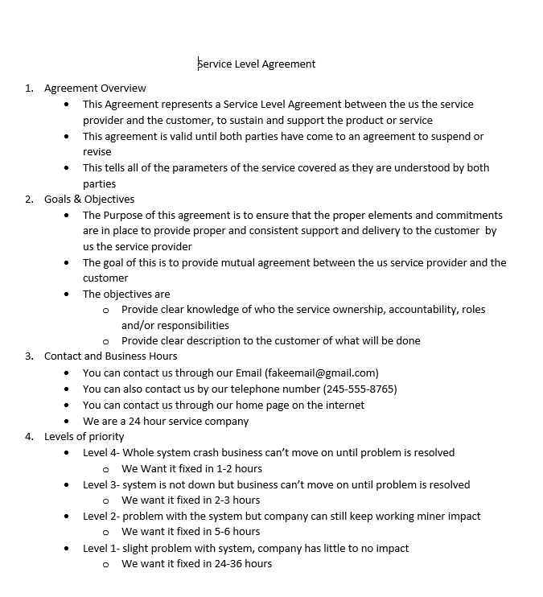
Service level Agreement
Example of our Agreement
4 parts to our agreement
4 levels of priority

Slide 4
Satisfaction Survey
Understand customer perception of service.
Ensure customer is has been satisfied.
Identify any particular areas to improve service toward varied demographics.
Give customer a chance to add suggestions outside of expected results.

Slide 5
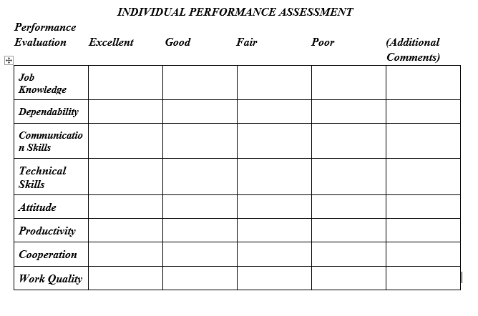
Monitoring Checklist
Customer Satisfaction
Customer feedback determines how happy customers are with the service
Customer satisfaction is key to retention and referrals
SLA Compliance
SLAs often incur penalties and fines if they are not met, not to mention customer dissatisfaction
SLAs address response times frames, appointment windows and resolution speed, scope and quality
First-Time-Fix-Rates
The most common re-visit reasons is the technician not have the correct tools or skills to fix the issue
Issues that can't be resolved on first visit cost thousands each year and leave customers disgruntled

